Slide 1
.NET CORE
Muhammad Akhlas Ahmed

Slide 2
What is .NET Core?
.NET Core is the new version of the .NET Framework, a free, open-source, general-purpose development platform maintained by Microsoft. It was designed to build modern, high-performance, and scalable applications that could run on Windows, macOS, and Linux. .NET Core aimed to provide a unified platform for developing various applications, including web applications, desktop applications, microservices, and more.

Slide 3
ASP.NET Core (.NET):
ASP.NET Core (.NET) is a free, open-source, and cloud-optimized framework that can run on Windows, Linux, or macOS. It is the new version of ASP.NET. The framework was completely rewritten to be open-source, modular, and cross-platform.

Slide 4
Why .NET Core Over .NET Framework?
There are some limitations to the .NET Framework. For example, it only runs on the Windows Platform. Also, you need to use different .NET APIs for different Windows devices such as Windows Desktop, Windows Store, Windows Phone, and Web Applications. The following are some of the reasons why you might choose .NET Core over .NET Framework for your application development:

Slide 5
Why .NET Core Over .NET Framework?
Cross-Platform Compatibility:
Open Source:
Performance and Modernization:
Long-Term Support (LTS):

Slide 6
.NET Core:
Developer(s): .NET Foundation Initial Release: .NET Core 1.0 – 27th June 2016 Stable Release: .NET 8 Preview Release: .NET 9 Repository: github.com/dotnet/core Written: C++ and C# Operating System: Windows, Linux, and macOS Type: Software Framework Website: dotnet.microsoft.com

Slide 7
.NET Core 3.1 (December 2019):
LTS (Long-Term Support) release.
Focus on stability and bug fixes.
Enhanced performance and support for cloud-native applications.
Blazor Server is used to build interactive web UIs using C#.
Improved performance for JSON serialization and deserialization.
Improved support for Azure Functions and Azure App Service.

Slide 8
.NET 5 (November 2020):
.NET Core and .NET Framework were merged into a unified platform called “.NET 5.”. Microsoft dropped the “Core” branding from .NET 5 onward to unify the .NET platforms.
Support for ARM64 architecture.
Improved support for containers and cloud-native development.
Improved single-file applications.
Better performance improvements, including garbage collection and System.Text.Json.
C# 9.0 with records, pattern-matching enhancements, and top-level programs.
F# 5.0 with interactive programming and a performance boost.
Blazor WebAssembly for full-stack web development with .NET.

Slide 9
NET 6 (November 2021):
Introduction of MAUI (Multi-platform App UI) for cross-platform app development.
Support for HTTP/3.
Unified platform for all .NET code.
Long-term support (LTS) release.
C# 10 and F# 6 with new features and enhancements.
Minimal API for simplified and clean API endpoints in ASP.NET Core.
Blazor Desktop allows Blazor components to run in desktop apps.
Hot reload capabilities for .NET apps across different application types.
AOT compilation for improved startup and support for Apple Silicon (M1).

Slide 10
.NET Core Composition:
The .NET Core Framework is composed of the following parts:
CLI Tools: A set of tooling for development and deployment.
Roslyn: .NET Compiler Platform.
CoreFx: A Set of framework libraries.
CoreCLR: A JIT-based CLR (Common Language Runtime). CoreCLR is the .NET execution engine in .NET Core, performing garbage collection and machine code compilation functions.

Slide 11
What Type of Application Can You Develop with ASP.NET Core?
Web: ASP.NET Core MVC, Web API, Razor Pages, and Microservices
Mobile
Console
Desktop Applications (Starting from 3.0)
IoT
ML
Gaming Applications
Cloud Applications

Slide 12
What is Blazor
How we develop web applications today?
What is Blazor, and why should we use it?
Setup our local machine for Blazor application development by installing the software and tools required.
How we develop web applications today?
what is Blazor?

Slide 13
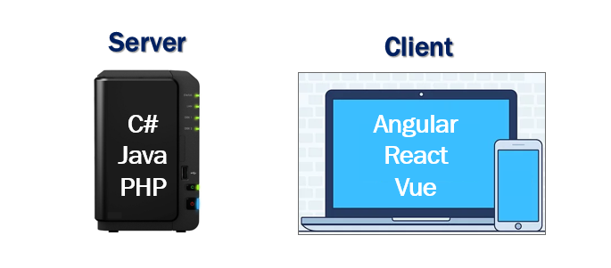

Slide 14
Question
Why should we learn and use 2 different sets of programming languages and frameworks.

Slide 15
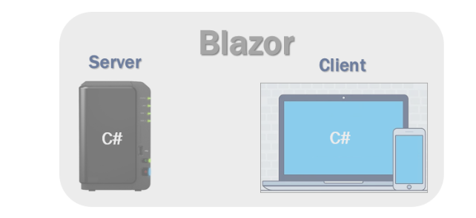

Slide 16
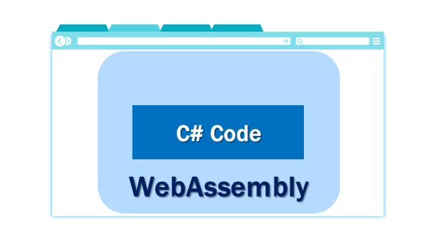
Question ?
How can a browser execute C# code?
Blazor can run C# code directly in the browser, using WebAssembly. It runs in the same security sandbox as JavaScript frameworks like Angular, React, Vue etc. Not just C#, in fact, we can run any type of code in the browser using WebAssembly.

Slide 17
Blazor hosting models
Blazor offers 2 hosting models. Blazor WebAssembly and Blazor Server.

Slide 18
Blazor WebAssembly
Everything the application needs i.e the compiled application code itself, it's dependencies and the .NET runtime are downloaded to the browser.

Slide 19
Blazor server
The application is executed on the server from within an ASP.NET Core application. Between the client and the server, a SignalR connection is established.

Slide 20
Intro To .Net WEB API
Web APIs enable systems developed on different technologies (like different programming languages or frameworks) to communicate effectively. For example, a mobile app built with Swift (iOS) can interact with a backend service written in ASP.NET Core (C#) using HTTP-based APIs.
They facilitate integration between different services and applications. For instance, a weather forecasting service may expose a Web API that other applications can query to get weather data, which they can then integrate into their own functionality.

Slide 21
Examples:
Social Media Integration: When a website integrates Facebook login, it uses Facebook’s API to authenticate users.
Payment Gateways: E-commerce sites use APIs from payment processors like PayPal or Stripe to handle transactions.
Weather Data: Apps that provide weather updates use APIs from weather services to fetch real-time weather data.
Google Maps API: Allows developers to embed maps and location services into their applications.
Twilio API: Enables applications to send SMS, make phone calls, and manage communications.

Slide 22
Key Characteristics of Web APIs:
HTTP-Based Communication: Web APIs are designed to work over HTTP, the same protocol used for Web Browsing. This means APIs can be accessed using standard HTTP methods like GET, POST, PUT, DELETE, etc. The API endpoints are typically represented as URLs (Uniform Resource Locators).
Data Exchange Formats: Web APIs use standardized data exchange formats such as JSON (JavaScript Object Notation) and XML (Extensible Markup Language) to structure and transmit data between the client and server. JSON has become the most popular format due to its simplicity and ease of use.
RESTful Architecture: Web APIs are designed to follow Representational State Transfer (REST) principles. A RESTful API is stateless, uses standard HTTP methods, and organizes resources into a hierarchy with unique URLs for each resource.
Authentication and Authorization: Web APIs implement security mechanisms for authentication and authorization to ensure that only authorized clients can access resources or perform specific actions. Common authentication methods include API keys, OAuth, and JWT (JSON Web Tokens).

Slide 23
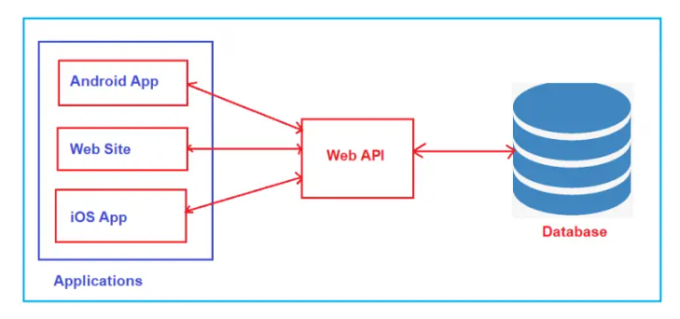
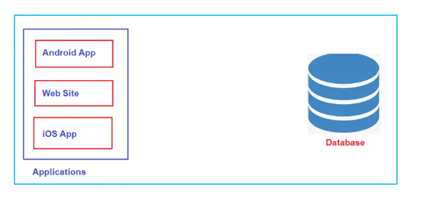
Why Do We Need Web API?
After website your business grows?

Slide 24
Difference Between ASP.NET Web API and ASP.NET Core Web API
ASP.NET Web API and ASP.NET Core Web API represent two different approaches to building Web APIs (Restful Services) within the ASP.NET framework, with several key distinctions:
Platform Support:
ASP.NET Web API: It is built on the .NET Framework, which means it runs only on Windows operating systems.
ASP.NET Core Web API: It is part of the ASP.NET Core framework, which runs on .NET Core. This allows it to be cross-platform, operating on Windows, Linux, and macOS. This is a significant advantage for developers aiming for broader application deployment across various environments.

Slide 25
Configuration and Hosting
ASP.NET Web API: Typically hosted in IIS (Internet Information Services), it heavily relies on system configuration through web.config files for both application settings and dependency configurations
ASP.NET Core Web API: Offers more flexibility in hosting options. It can be hosted in IIS, Kestrel (a cross-platform web server built for ASP.NET Core), or even in Docker containers. Configuration can be achieved through various sources like JSON files, environment variables, command-line arguments, etc., without relying on web.config.

Slide 26
Dependency Injection
ASP.NET Web API: Supports dependency injection, but it is not built into the framework. Developers often need to use third-party libraries like Unity or Ninject to achieve dependency injection.
ASP.NET Core Web API: Dependency injection is a first-class citizen in ASP.NET Core. The framework has built-in support for dependency injection, which promotes more loosely coupled code and better manageability.

Slide 27
Why Do We Need the Dependency Injection Design Pattern in C#?
The Dependency Injection Design Pattern in C# allows us to develop Loosely Coupled Software Components. In other words, we can say that Dependency Injection Design Pattern is used to reduce the Tight Coupling between the Software Components. As a result, we can easily manage future changes and other complexities in our application. In this case, if we change one component, then it will not impact the other components.

Slide 28
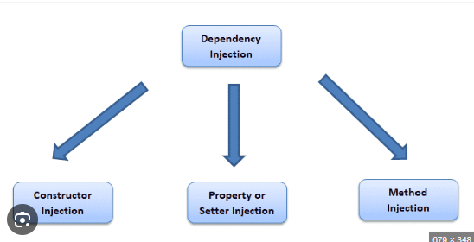

Slide 29
Middleware Support
ASP.NET Web API: This does not have middleware support the way ASP.NET Core does. Custom handlers and modules can be created, but they are generally more complex to implement and integrate.
ASP.NET Core Web API: Uses a middleware pipeline that is easy to customize and configure. Middleware components can be used to execute code before and after your application handles a request, enabling scenarios like authentication, error handling, and logging with less complexity.

Slide 30
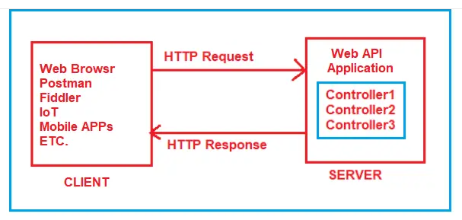
Routing in ASP.NET Core Web API Application

Slide 31

